Slide 1
Networking Review (Architecture)
UT CS361S – Network Security and Privacy
Spring 2021
Lecture Notes

Slide 2
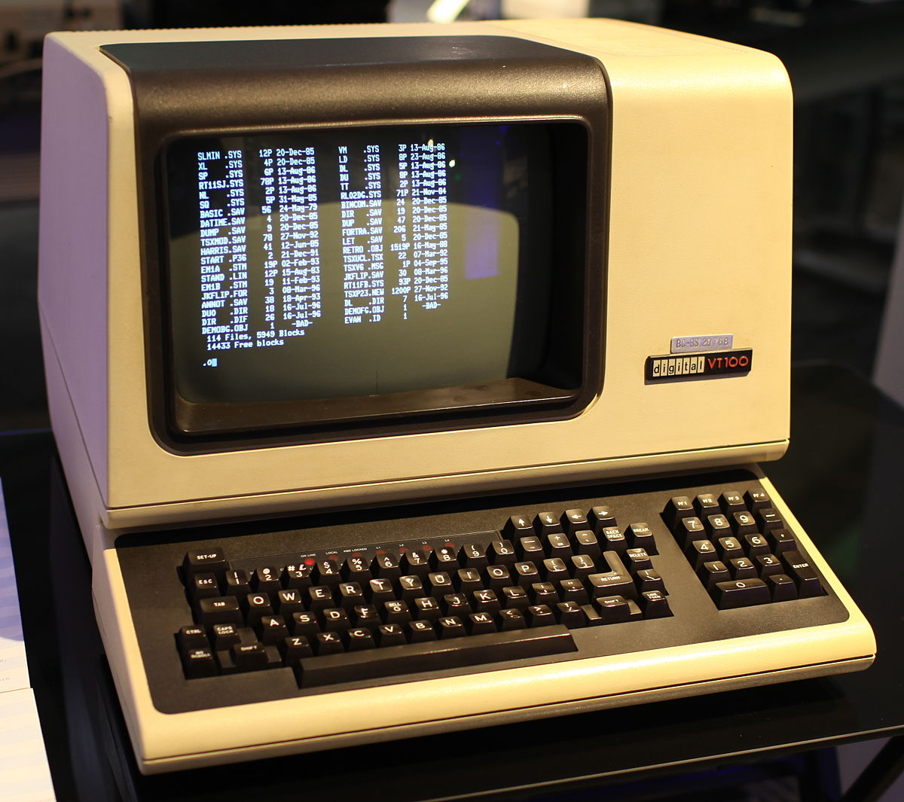

Computing 1960-1980 (ish)
NETWORK
This Photo by Unknown Author is licensed under CC BY-SA-NC
“DUMB” TERMINAL
MAINFRAME
This Photo by Unknown Author is licensed under CC BY-SA

Slide 3
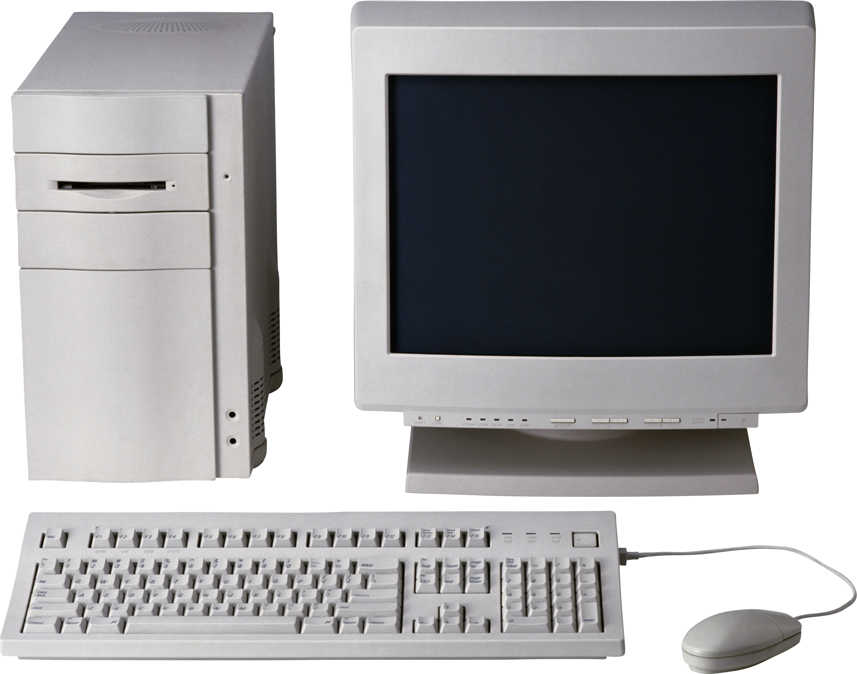
Computing 1980-2000 (ish)
This Photo by Unknown Author is licensed under CC BY-NC

Slide 4
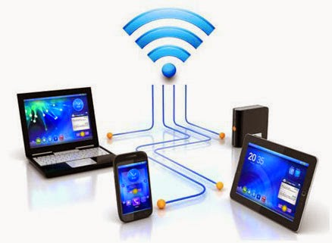
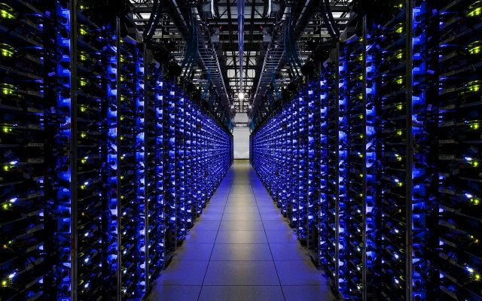
Computing 2000 – Present
NETWORK
This Photo by Unknown Author is licensed under CC BY
This Photo by Unknown Author is licensed under CC BY-NC-ND

Slide 5
Simplified Network Communication
Two participants; we will call each one a “node”
Data is transmitted between participants in packets (chunks)
Packet includes metadata, usually prepended as a header
Header includes sender’s address and receiver’s address
Receiver can “reply” to sender’s packets by reversing addresses

Slide 6
ADDRESS: A
ADDRESS: B
TO: B
FROM: A
{DATA}
TO: A
FROM: B
{DATA}

Slide 7
Also, Network Discovery
Many communication patterns require discovery
Either, the discovery of the existence of nodes
And/or discovery of how to communicate with a specific node

Slide 8
Local Network Concepts
Local Area Network (LAN) – Direct node-to-node connection
Usually involves a “medium”, hence Medium Access Control
Nodes can send or receive MAC packets w/ MAC addresses
Broadcast typically used for discovery

Slide 9
“Old” Ethernet (< 10mbps)
Broadcast used for everything
Each node would only respond to packets addressed to it
Upon detecting a collision, node would randomly back-off

Slide 10
ADDRESS: C
Not for me!
ADDRESS: A
ADDRESS: B
BOADCAST
TO: B
FROM: A
{DATA}
ADDRESS: D
Not for me!

Slide 11
Modern Ethernet
Switches ensure the data is delivered to the right node
Broadcast (flooding) used to find a node the first time
Much more efficient; enables 100Mbs+

Slide 12
ADDRESS: C
ADDRESS: A
SWITCH
ADDRESS: B
TO: B
FROM: A
{DATA}
ADDRESS: D
Message from A on port 1. No idea where B is yet…

Slide 13
ADDRESS: C
ADDRESS: A
SWITCH
ADDRESS: B
TO: B
FROM: A
{DATA}
ADDRESS: D
Send message to all ports except port 1

Slide 14
ADDRESS: C
TO: A
FROM: B
{DATA}
ADDRESS: A
SWITCH
ADDRESS: B
ADDRESS: D
B is sending a message on port 3. I’ll remember that…

Slide 15
ADDRESS: C
TO: A
FROM: B
{DATA}
ADDRESS: A
SWITCH
ADDRESS: B
ADDRESS: D
Sending message to port 1, because that’s where A was last time

Slide 16
IP Address Mapping
MAC addresses are great, but app layer doesn’t use them
Even when communicating on your LAN, you use IP addrs
To communicate, IP-to-MAC address mapping required
Enter the Address Resolution Protocol (ARP)

Slide 17
ARP Broadcast Discovery
Every LAN has an explicit broadcast mechanism
Ethernet typically uses broadcast address FF:FF:FF:FF:FF:FF
When IP with unknown MAC mapping needed, broadcast
Ask all nodes on the LAN “who has IP addr X, tell IP addr W”

Slide 18
IP: Y
MAC: C
IP: W
MAC: A
IP: X
MAC: B
BOADCAST
TO: ALL
FROM: A
Who has IP X? Tell IP W
IP: Z
MAC: D
Hey, that’s me!

Slide 19
IP: Y
MAC: C
IP: W
MAC: A
IP: X
MAC: B
ARP Response
ARP TABLE:
IP X <-> MAC B
TO: A
FROM: B
I have IP X
IP: Z
MAC: D

Slide 20
IP to MAC conversion
Once ARP has the IP to MAC in the table, conversion is easy
Translation occurs in Ethernet layer during “push” from IP
IP destination addr is looked up in ARP table
PS, what “layer” in OSI is ARP?

Slide 21
Internetworking Concepts
We’ve covered how to talk to a LAN node.
What about a node outside our broadcast domain?
Requires internetwork routing

Slide 22
Exiting the LAN
A gateway node is connected to TWO+ LANs
For any external IP address, use the MAC addr of the gateway
(True dest IP addr remains the same!)
Gateway node will examine the dest IP addr
Gateway node determines where to send the data next

Slide 23
LAN 1 LAN 2
IP Packet
SRC: W
DST: M
IP Packet
SRC: W
DST: M
ARP TABLE:
GW <-> MAC B
ETHERNET PROTOCOL
ETHERNET PROTOCOL
ETHERNET PROTOCOL
ETHERNET
SRC: A, DST: B
ETHERNET
SRC: B, DST: C
ETHERNET
SRC: B, DST: C
SRC: W, DST: M
SRC: W, DST: M
SRC: W, DST: M
IP: W
MAC: A
(GW) IP: X
MAC: B
IP: M
MAC: C

Slide 24
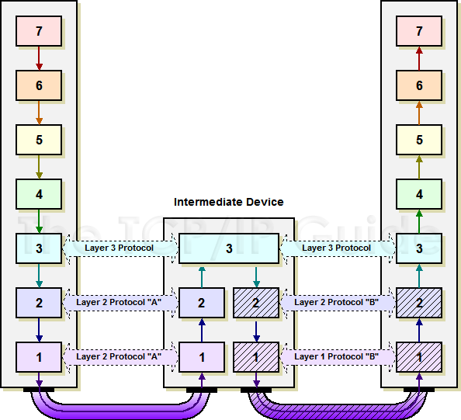
http://www.tcpipguide.com/free/t_IndirectDeviceConnectionandMessageRouting.htm

Slide 25
Routing Across the Internet
Data may have to move up a hierarchy
You to a Tier-3 ISP to a Tier-2 ISP, to a Tier 1 ISP
Top level ISP’s usually manage the “Autonomous Systems” (AS)
AS’s are the top level of the Internet in terms of routing
AS’s are interconnected and represent the “backbone”

Slide 26
Border Gateway Protocol (BGP)
…
AS 1
AS 2
AS 60,000+
TIER 1 ISP’s
(Enable most AS’s. As the AS’s are not fully connected, carry traffic for each other)
TIER 2 ISP’s
(Large Scale Systems)
TIER 3 ISP’s
(Last Mile ISP)
INTERNET USERS
(Individuals, Businesses, etc.)

Slide 27
Default Routes
Many routers don’t know specifically where to send data
A default route (or a default router) passes up the hierarchy
Routers in the AS’s have no default route
Routers in the AS’s build tables to know where to send data
(The buck stops here)

Slide 28
Domain Name System (DNS)
We don’t usually browse the web with IP addresses
You can, of course. Try browsing to 172.217.13.4
But what a pain to remember
DNS is how we convert “google.com” to “172.217.13.4”

Slide 29
Client-Server Concepts
Put resources in a high-performance, centralized machine
Clients can be much “dumber” by comparison
Much more efficient
Sharing data between devices, applications, and people
Access from multiple locations (including hackers!)
Time-sharing a central machine is more scalable & cost-effective

Slide 30

Server Abstraction
I’m Lonely. I wish someone would talk to me!
This Photo by Unknown Author is licensed under CC BY-SA
SERVER LISTENS FOR INCOMING REQUESTS

Slide 31

Preview of TCP/IP
Now I have an Address/Port! Maybe I’ll get Requests!
IP: 192.168.0.1
PORT: 80
This Photo by Unknown Author is licensed under CC BY-NC
This Photo by Unknown Author is licensed under CC BY-SA
SERVER HAS AN IP ADDRESS AND TCP PORT

Slide 32

Meanwhile, Client Abstraction
HELLO?!
This Photo by Unknown Author is licensed under CC BY-NC
CLIENT CONNECTS TO MAKE OUTBOUND REQUESTS

Slide 33

TCP/IP Again
HELLO?!
TO: 192.168.0.1:80
FROM: 192.168.0.2:5280
Usually random
This Photo by Unknown Author is licensed under CC BY-NC
This Photo by Unknown Author is licensed under CC BY-NC
CLIENT CONNECTS TO MAKE OUTBOUND REQUESTS

Slide 34
Incoming Request
I GOT A REQUEST!!!
REQUEST
TO: 192.168.0.1:80
FROM: 192.168.0.2:5280
This Photo by Unknown Author is licensed under CC BY-SA
SERVER RECEIVES REQUEST

Slide 35
Request Response
MY NEW PENPAL!
RESPONSE
TO: 192.168.0.2:5280 FROM: 192.168.0.1:80
This Photo by Unknown Author is licensed under CC BY-SA
SERVER INVERTS TO/FROM FOR RESPONSE

Slide 36
Server Listens to Many Requests
SERVER USES (SRC IP, SRC PORT, DST IP, DST PORT)* TO MULTIPLEX
This is how one server on one port (e.g., webserver) handles many clients, even from the same computer
192.168.1.1, 5280, 192.168.1.2, 80 | Web Server Process 1
192.168.1.1, 9019, 192.168.1.2, 80 | Web Server Process 2

